Slide 1


Lane Detection System for Traffic Control
RA1911032010055 Palakuru Akhilesh
RA1911032010042 Kanna Prem chand
RA1911032010037 U Brunda
RA1911032010061 MD Shoyab Althaf

Slide 2
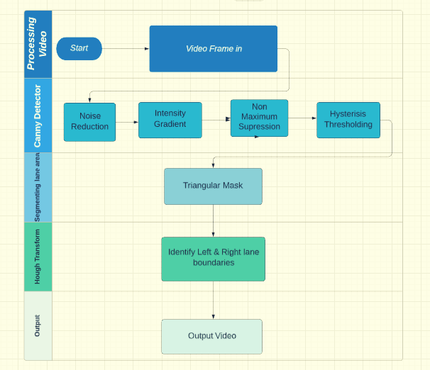
Problem statement
The drivers' behavior model results showed that drivers who did sudden lane changes are more likely to be involved in traffic crashes. The drivers who look towards the side mirrors and who look out the windows before lane-change intention have less probability to be involved in crashes. Crashes due to lane departures are among the deadliest collision types; passenger vehicle crashes due to unintentional lane departure killed people in the US. Lane departure warning systems (LDW) and lane departure prevention systems (LDP) in vehicles assist drivers to prevent lane departures. Thus, our primary objective is to provide an accurate lane detection system for these warning systems also it can significantly help the drivers to drive responsibly there by providing us with safer environments.
Importance:
The detection and identification of the lane line is to realize the intelligence and automation of the modern transportation system.
It has a good application in the fields of advanced parking assistance, lane keeping assistance, off-road warning, and lane change assistance.
The causes of comprehensive traffic accidents mainly include four aspects:
The car’s own performance, drivers, roads, and environment. Among these four aspects, the driver’s personality, fatigue driving, and drunk driving are the most common causes of accidents.
When the car is in motion, the driver dominates, and the driver’s driving operation directly determines the stability and safety of the vehicle during driving.
Thus, with intelligent driving systems and accurate warning systems, we can effectively reduce the driver's workload and assist the driver's decision making abilities.
Techniques:
Canny detector:
Identifying left and right lane boundaries
Triangular mask
No maximum supression
Noise reduction
Process diagram:

Slide 3
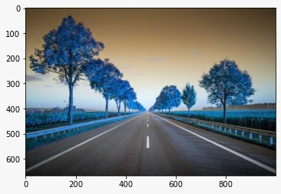
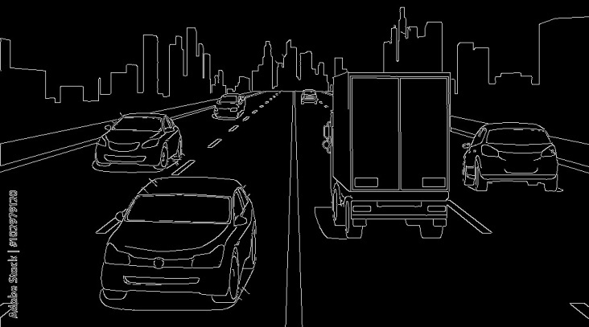
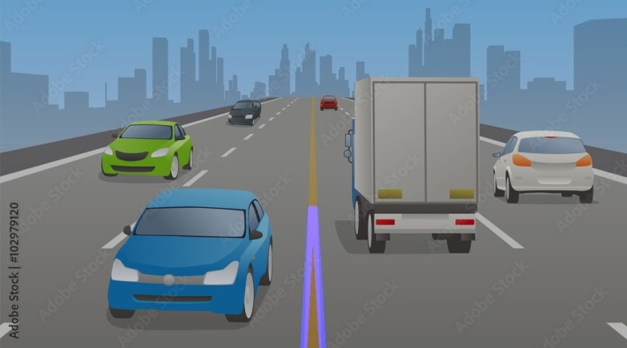
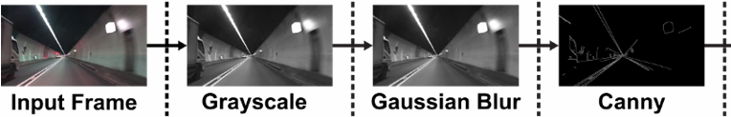
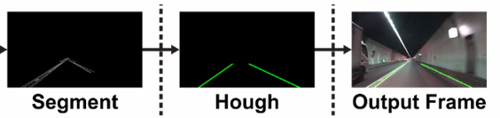
Graphs and diagrams
Lane graph
Edge
Lanes
Flow Chart
The future scope of the lane detection includes complex environment taking into account the different environments such as the Weather conditions: fog, mist, cloudy, sunny, bright day light, darker, shadow or when there occurs obstacles and Humps, Speed Breakers in the Road.
Future suggested enhancements

Slide 4
THANK YOU

